Slide 1
Canny edge detection – fpga speedup
David watts
Max dunevitz

Slide 2
Canny Edge Detection
A multi-stage image edge detection algorithm developed by John Canny in 1986
The algorithm involves two main steps
Calculation and comparison of the intensity gradients of pixels to locate edges
Hysteresis thresholding of the gradient magnitudes of pixels to refine the edge detection and suppress “weaker” edges

Slide 3
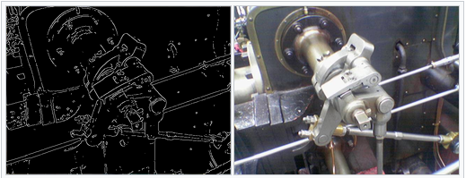
Example of a processed image

Slide 4
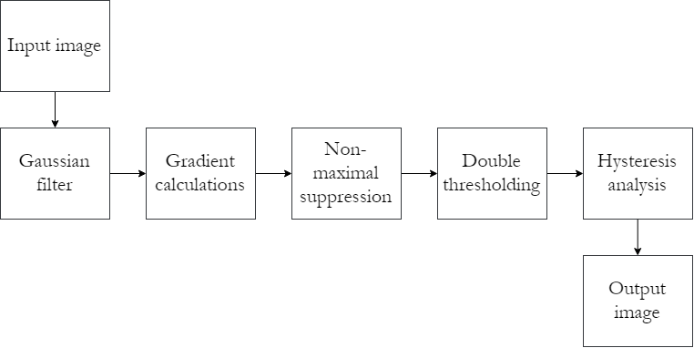
Full Algorithm Overview

Slide 5
Project Overview
To speed up the Non-maximal Suppression (NMS) and thresholding steps of the algorithm by processing these steps on hardware using an FPGA
Process
Calculation of the gradients is performed in software
The gradient magnitudes and directions are passed to the FPGA
FPGA performs NMS and thresholding and returns a binary image to the user
Note that the hysteresis thresholding is simplified to a simple binary threshold against a single value
Processing time in software and hardware are compared to calculate the speedup

Slide 6
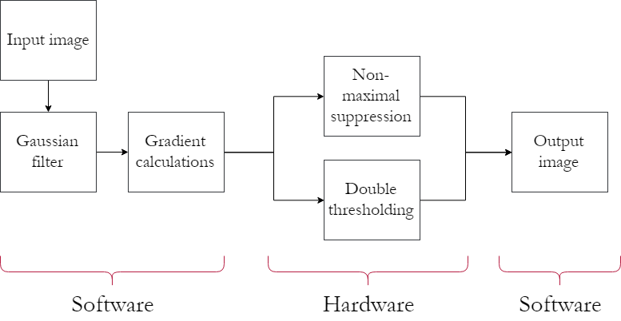

Project Algorithm Overview

Slide 7
Software implementation
The algorithm is coded using C++ coupled with the OpenCV libraries in software
Process overview
Gradient magnitudes and directions are calculated, then output to a CSV file
The CSV file is loaded to the server which parses it and writes entries to the FPGA
The FPGA processes the data and the binary image is returned in a reverse manner
Comparison of software/hardware bridged approach to software-only approach

Slide 8
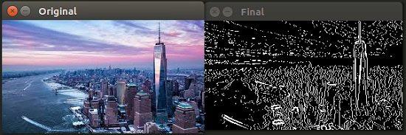
Software-Only output

Slide 9
Hardware Datapath
Datapaths created for the NMS and thresholding blocks
NMS block
Input: Magnitudes (8-bit integers) of all pixels in a 3x3 square and the direction (3-bit integer) of the center pixel
Output: single bit indicating that the pixel is kept (1) or suppressed (0)
Thresholding block
Input: Magnitude of the center pixel
Output: single bit indicating that the pixel passes (1) or fails (0) the threshold
M0 | M1 | M2
M3 | M4 | M5
M6 | M7 | M8
+
D4

Slide 10
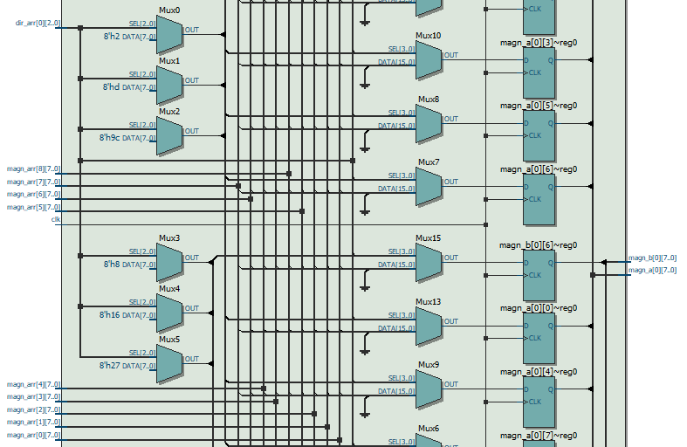
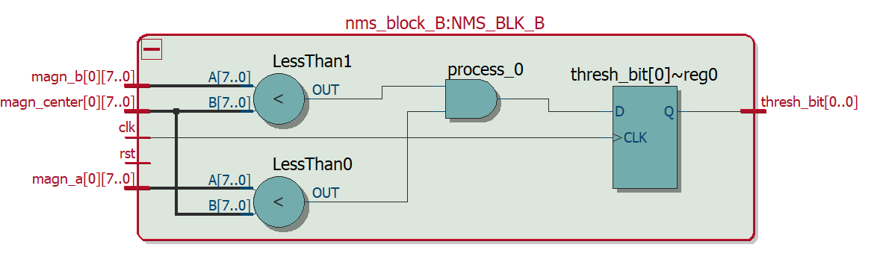
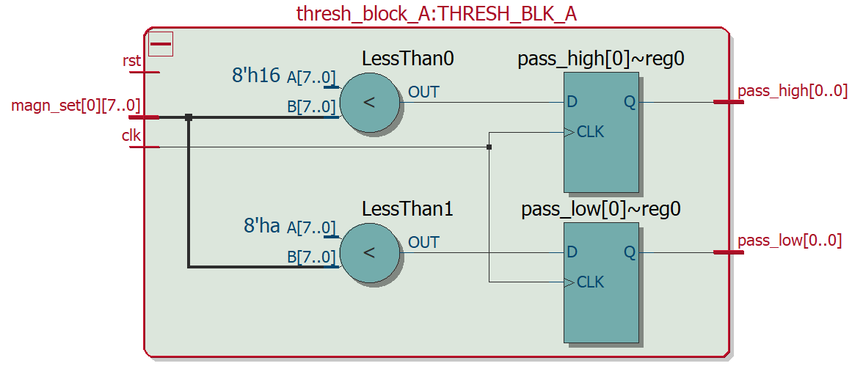
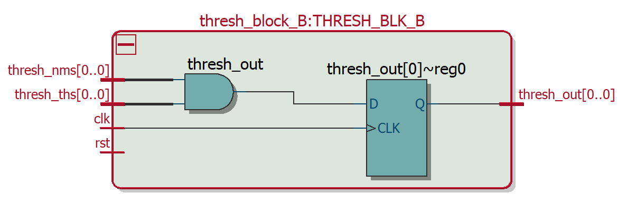
NMS Block A
NMS Block B
Thresholding Block A
Thresholding Block B

Slide 11
memory mapping
3 input RAM’s
Each RAM contains N-1 rows of pixels from the input image (N is number of rows in image)
CPU will be writing identical data to each RAM with some offset
This allows us to “unroll” the datapath 3 times
With unrolling, there is a 3 cycle latency to fill the buffer

Slide 12
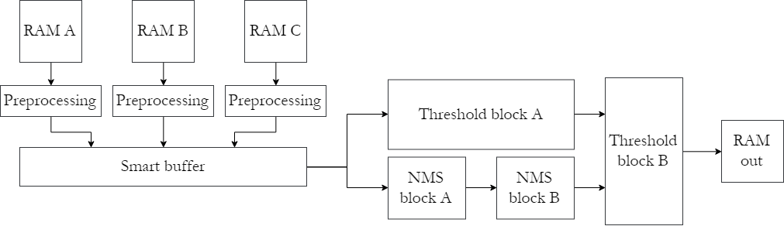
Hardware flow
16-bit magnitude
+
16-bit angle
Binary value
3x3 Pixel Block

Slide 13
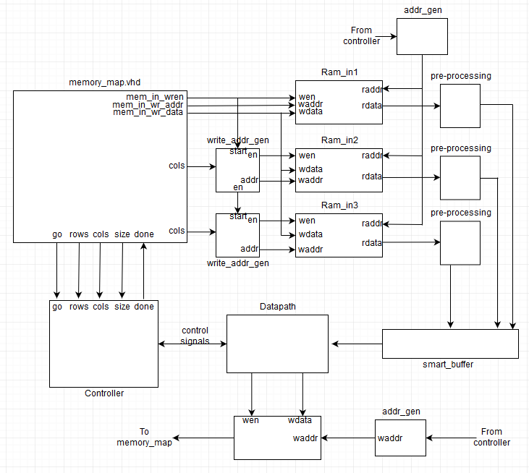
Full Architecture

Slide 14
Results
Unable to achieve output on ZedBoard
Can write to board and process completes
Output is invalid (all ‘0’s)
Implemented in simulation
Parsing the input CSV files
Loading input RAMs
Writing outputs to a new file

Slide 15
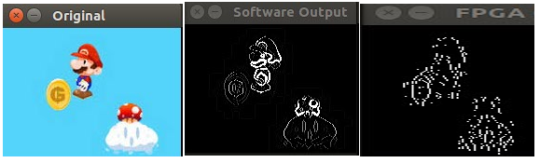
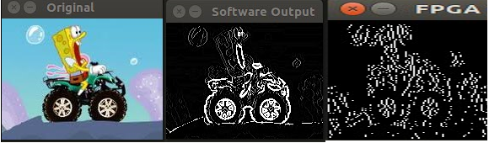
Example outputs

Slide 16
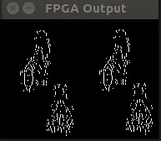
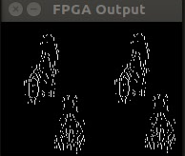
Image Mirroring glitch
Raw recreated image
What it should look like

Slide 17
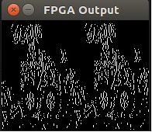
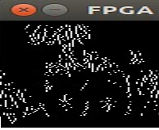
Thresholding sensitivity
Threshold of
0x1600
Threshold of
0xDE00

